Slide 1

Taking the Stage®

Slide 2


By taking the stage, you will thrive as a leader.

Slide 3
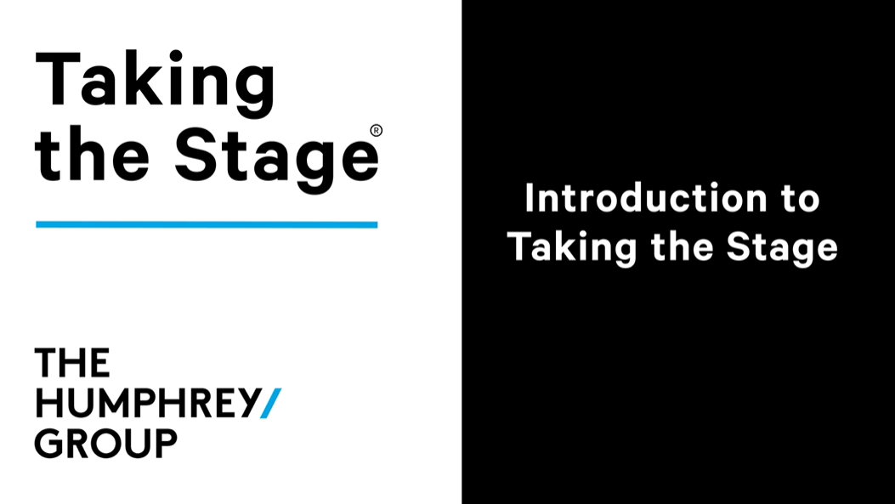
Notes:
Use the link provided to view the video.
https://vimeo.com/1089143236?share=copy#t=0
Password to view videos: “THGTTS”

Slide 4
GROUND RULES
RULE 1: Maintain confidentiality.
RULE 2: Allow everyone a voice.
RULE 3: Supportive, safe environment.
RULE 4: Stay constructive, not critical.

Slide 5

EMBRACE YOUR LEADERSHIP IDENTITY
THE LEADER’S SCRIPT & THE LANGUAGE OF LEADERSHIP
POWER OF VOICE AND PRESENCE
INSPIRING CONVERSATIONS

Slide 6
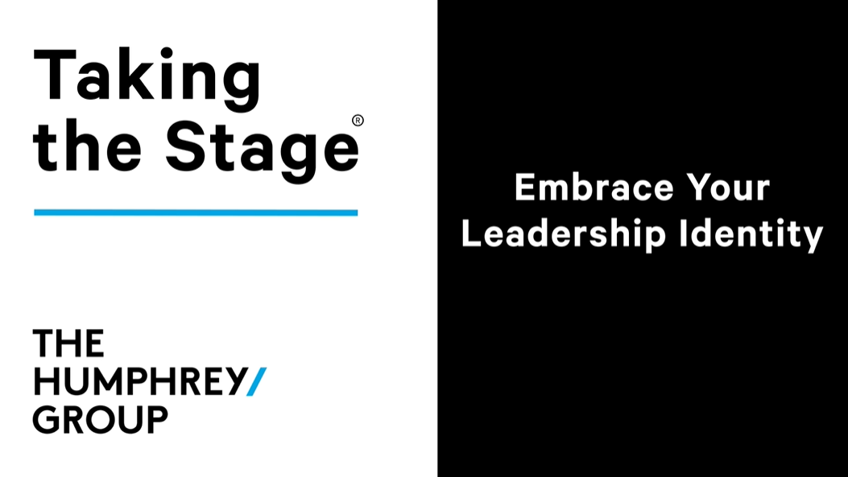
Notes:
Use the link provided to view the video.
https://vimeo.com/1089142444
Password to view videos: “THGTTS”

Slide 7






THE LEADER’S MINDSET
VISION
• end goal or destination
• clear and achievable
• guides your words and actions EVERYDAY
COURAGE
• allows you to deliver difficult messages
• equips you to face change, discomfort, and challenges
• based on your CONVICTION
CONVICTION
• based on your authentic beliefs
• grounds your VISION
• helps you practice COURAGE
EVERYDAY
• consistency shows others what to expect from you
• develops your personal leadership brand
• gets you closer to your VISION
INFORMATION TO INSPIRATION
• means putting the takeaway before the evidence
• helps you persuade and drive action
• is audience-centered
AUDIENCE-CENTERED
• putting your audience first
• using INFORMATION TO INSPIRATION
• must be balanced with your authentic CONVICTION

Slide 8


CONVICTION EXERCISE
INSTRUCTIONS:
Write down 3-5 of your core beliefs or convictions.
Choose the one you feel most strongly about.
Share this conviction with the group.

Slide 9



CONVICTION STATEMENT EXAMPLES
ABOUT YOURSELF
ABOUT YOUR TEAM
ABOUT YOUR ROLE
“I believe that failure is where growth happens.”
“I believe that our inclusive culture empowers our team to connect and grow.”
“I believe that my compassionate leadership is the key to the retention of our staff.”

Slide 10

REFRAMING THE IMPOSTER EXERCISE
INSTRUCTIONS:
Write down a negative statement you might hold about yourself.
Write a positive conviction statement that reframes this negative statement.
Be ready to share these statements with the group.
Example: | Negative statement: “I got this position because of luck.” Reframing statement: “I got this position because of hard work and determination.”

Slide 11

BREAK
- 15 minutes -

Slide 12


BRAG EXERCISE
INSTRUCTIONS:
Write down a negative statement you might hold about yourself.
Write a positive conviction statement that reframes this negative statement.
Be ready to share these statements with the group.

Slide 13

VISION EXERCISE
INSTRUCTIONS:
You will be paired up with a partner.
Share your Vision. Talk about where you see yourself heading in your career, or as a leader in general.
When it is your turn to listen, ask questions and encourage your partner to elaborate and keep speaking.

Slide 14
THE LEADER’S SCRIPT & THE LANGUAGE OF LEADERSHIP
EMBRACE YOUR LEADERSHIP IDENTITY
POWER OF VOICE AND PRESENCE
INSPIRING CONVERSATIONS

Slide 15
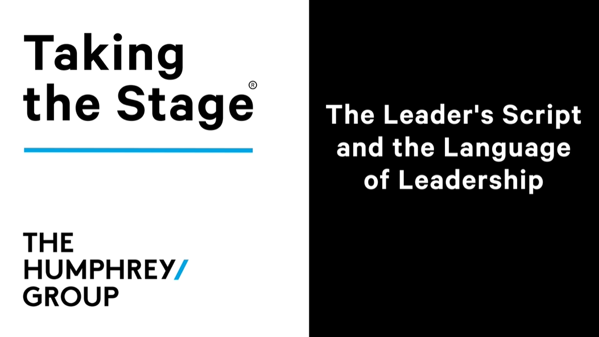
Notes:
Use the links provided to view the videos.
https://vimeo.com/1089141581
Password to view videos: “THGTTS”

Slide 16
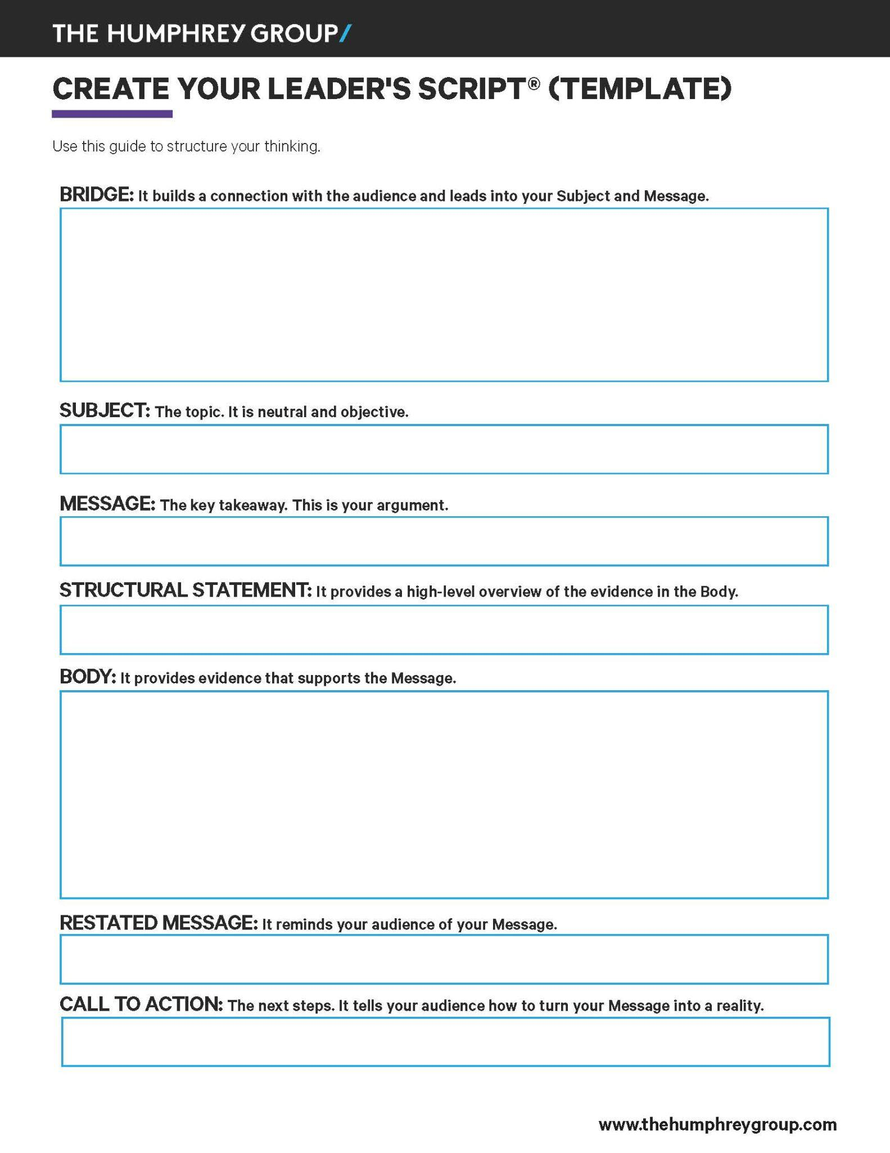

The Leader’s Script

Slide 17

SUBJECT
The topic
Neutral and objective
No one can disagree because it’s a fact
Example: “Let’s talk about our sales strategy for Product X.”
Example: “I want to talk to you about our invoicing process.”

Slide 18






5 CRITERIA FOR AN EFFECTIVE MESSAGE
1
Your Belief
2
Positive
3
Audience-
Centered
4
Supported with Facts
5
Aligned with the Organization

Slide 19
APPLY THE LANGUAGE AN EFFECTIVE MESSAGE
1
Your Belief
2
Positive
3
Audience-
Centered
4
Supported with Facts
5
Aligned with the Organization
“I believe that…”
“My message to you is…”
“I am confident that…”
“This presentation will conclusively demonstrate that…”
“Our team firmly believes that…”

Slide 20


MOVE FROM NEGATIVE TO POSITIVE
Negative Message
Positive Message
“I believe that we don’t have enough resources to complete this task on time.”​ ​
“I’m convinced that with more resources we will complete this project on time.”​ ​

Slide 21

HOW CAN YOU MAKE THIS MESSAGE
FIT THE CRITERIA?
Draft Message #1
“If we don’t change strategies now, we won’t be able to keep up with our competitors.”

Slide 22
HOW CAN YOU MAKE THIS MESSAGE
FIT THE CRITERIA?
Improved Message #1
“My message to you is that in order to experience higher growth this quarter, we need to revamp our sales strategy.”
Notes:
Why is this better?
It shows that taking an action ("revamp our sales strategy") will result in a benefit ("experience higher growth this quarter") for the intended audience.
This message is clear, direct, and actionable.

Slide 23

HOW CAN YOU MAKE THIS MESSAGE
FIT THE CRITERIA?
Draft Message #2
“We need to improve our invoicing process.”

Slide 24
HOW CAN YOU MAKE THIS MESSAGE
FIT THE CRITERIA?
Improved Message #2
“I’m confident that by digitizing our invoicing process, we can save money.”
Notes:
Why is this better?
Instead of giving an order, the improved version highlights a solution that emphasizes positive benefits. It is persuasive and actionable.

Slide 25

HOW CAN YOU MAKE THIS MESSAGE
FIT THE CRITERIA?
Draft Message #3
“The key to retaining top talent is to develop them.”

Slide 26
HOW CAN YOU MAKE THIS MESSAGE
FIT THE CRITERIA?
Improved Message #3
“I believe that prioritizing learning and development for key positions will allow us to increase talent retention.”
Notes:
Why is this better?
It is more explicit in its positive outcome.

Slide 27



PRACTICE AUDIENCE-CENTERED THINKING
What do you believe that you want your audience to believe?
What is the benefit they would gain from taking that action?
What is the single takeaway of your message?

Slide 28
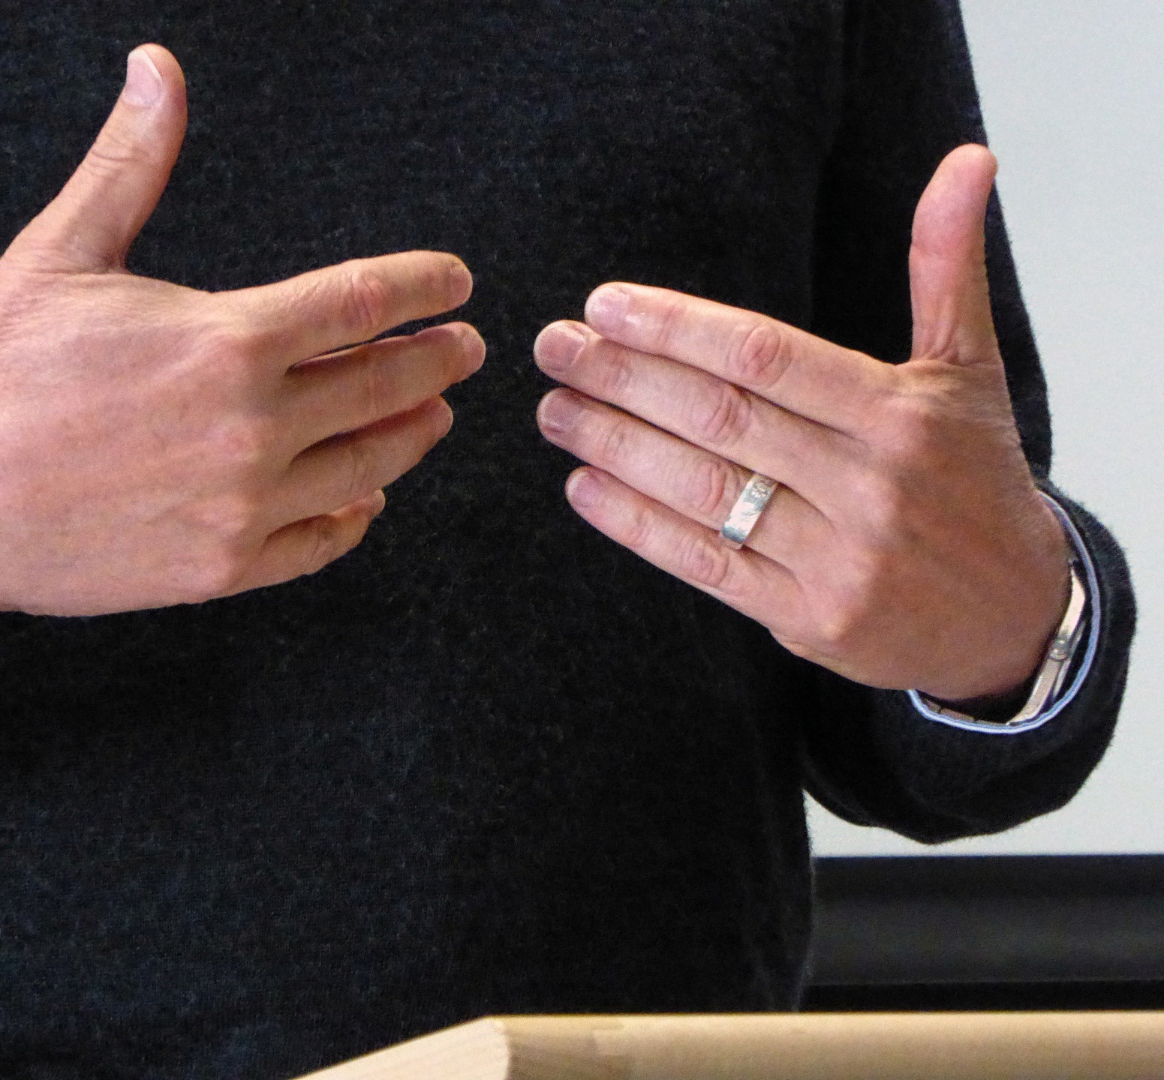
BRIDGE
The context that connects you to your audience
Can be a personal story, an anecdote, a quote, a metaphor, relevant facts, and information
Can be short or long but it must connect to your Subject & Message
Example: “It’s estimated that by 2050, our oceans will have more plastic - by weight - than fish. This is why it is crucial to reduce single-use plastic and focus on sustainable alternatives.”

Slide 29






STRUCTURAL STATEMENT
A high-level overview of the evidence included in the Body.
It can follow 1 of 5 possible models:
Reasons - “There are 3 reasons we should pursue this approach: A, B, and C.”
Ways - “Here’s how we can cut costs: first we do A, then B, and finally C.”
Situation/Response - “First I’ll tell you why we need to make this change, then I’ll tell you how we can do it.”
Present/Future - “Let me tell you how we use to handle these types of situations, and then I’ll tell you how we’re going to handle them moving forward.”
Chronological - “Now, I’m going to walk you through how this situation has evolved over the past 5 years.”

Slide 30

BODY
Presents evidence that supports the Message
Follows the structure your Structural Statement laid out
Example: “First, it will allow us to cut on printing costs. Second, it will save us time. Third, it will cut down on our workload.”

Slide 31

RESTATED MESSAGE
Reminds your audience of your Message
Example: “As you can see, this is why I believe that by investing in training for all of our employees on how to give and receive feedback, we will cultivate a feedback-friendly environment.”

Slide 32
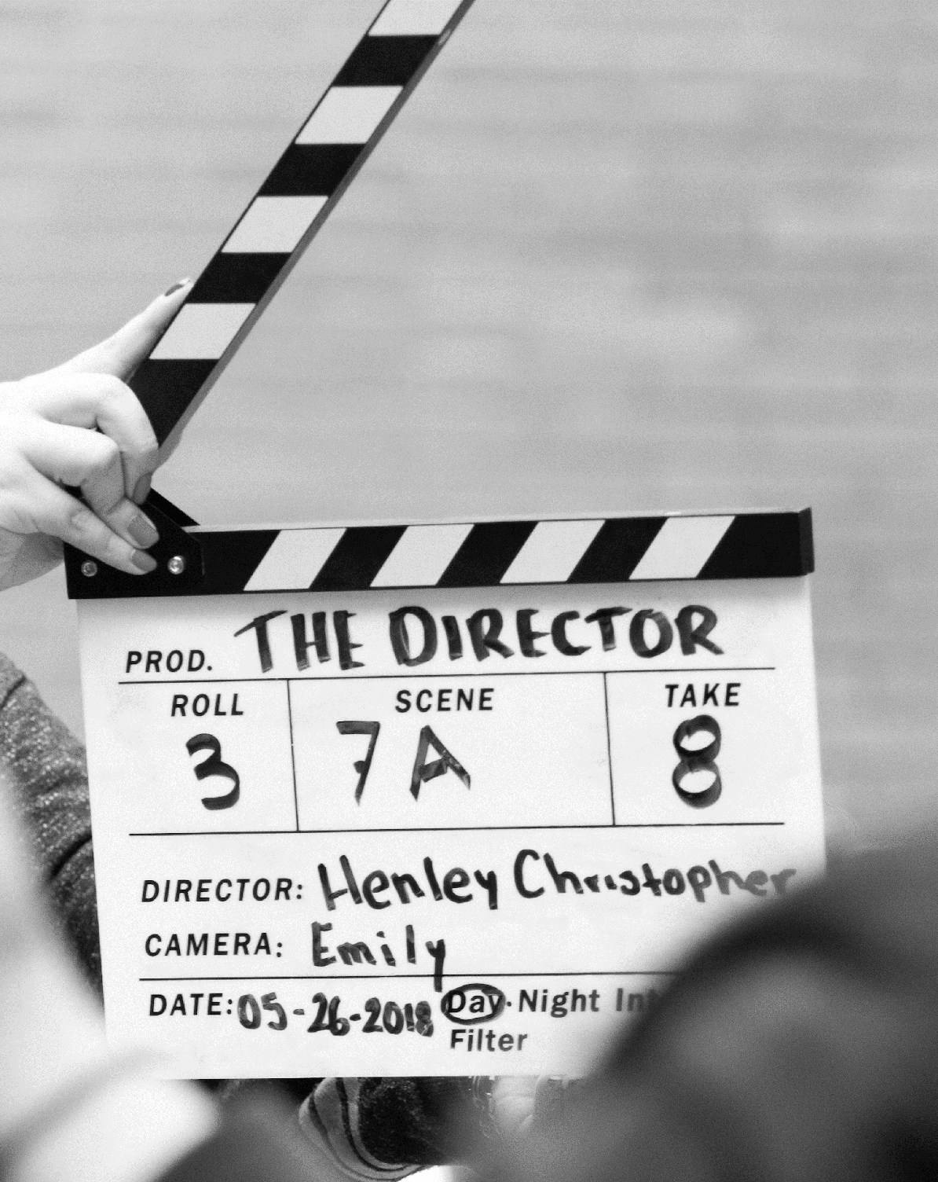
CALL TO ACTION
Outlines the next steps needed to make your Message a reality. It is:
            (C) – Concrete (be as specific as possible)
            (T) – Time-Stamped (set a deadline)
            (A) – Assigned (name one specific accountable party)
Example: “John, please sign this proposal and send it back by Monday.”

Slide 33
LEADER’S SCRIPT EXAMPLES

Slide 34
LEADER’S SCRIPT EXAMPLE
BRIDGE:
I’ve never been a fan of chasing fads purely for the sake of chasing fads. When everyone started doing everything digitally in March 2020, I was pretty hesitant to make the transition. I thought to myself: “we’ve always done things this way, and it’s always worked for us. So why change what isn’t broken?” But then the lockdown happened. And customers became hesitant to accept paper copies of their invoices. They started asking us to scan their invoices instead, because of COVID-19 precautions. And that’s when it became clear to me that this wasn’t just a fad – that this wasn’t just going to pass quickly. This is just the way things are now. So I started thinking seriously about how we could adapt – and I’m pleased to say that I have a solution that will actually make this whole digitization work to our advantage.
SUBJECT:
Let’s talk about our invoicing process.
MESSAGE:
I’m confident that by digitizing our invoicing process, we can save money.
STRUCTURAL STATEMENT:
There are 3 reasons why this is the best strategy.
BODY:
First, it will allow us to cut on printing costs. Second, it will save us time. Third, it will cut down on our workload.
RESTATED MESSAGE:
As you can see, digital invoicing is the way to go as it will save us money.
CALL TO ACTION:
Please review the attached proposal for our new digital invoicing process by next week and write to me with any questions you have. I’ve scheduled a meeting next Friday to discuss implementation.

Slide 35
LEADER’S SCRIPT EXAMPLE
BRIDGE:
“They are a great culture fit.” “I love the vibe of this candidate.” Have you heard these statements during a hiring process debrief? Or even used them yourselves? While these might seem harmless, they are examples of explicit and implicit bias. Numerous studies have shown that unconscious hiring bias leads to bad hiring decisions, a lack of diversity, early turnover, and hinders an organization’s ability to innovate.
SUBJECT:
This is why I am here today to talk about our hiring process.
MESSAGE:
I’m convinced that a mindset shift from “culture fit” to “culture add” will lead to a more inclusive hiring process.
STRUCTURAL STATEMENT:
I will tell you two ways we can change our approach:
BODY:
Establishing diverse interview panels: The “culture add” mindset recognizes that to find people who add something different, we need many different perspectives on the interview panel. Having diverse interview panels will help us minimize bias in our selection process.
Standardizing our interview process: “Culture adds” will stand out when everyone answers the same questions. By having the same questions based on technical competencies that align with the job role, we will have objective data that can be graded on a scorecard.
RESTATED MESSAGE:
As you can see, shifting our hiring process approach to intentionally seek “culture adds” will make for a more inclusive hiring process.
CALL TO ACTION:
Please review the attached proposal which outlines the suggested changes to our hiring process. I will be scheduling a meeting at the end of April to discuss its implementation.

Slide 36
LEADER’S SCRIPT EXAMPLE
BRIDGE:
A few months ago, I came across a famous story about President John F. Kennedy, when he visited NASA’s headquarters in the 1960s. During his visit, he met many people and asked what their job was and what they were doing. In the hallway he met a janitor who was carrying a broom. The President walked over to him and asked: “What do you do here?” The janitor responded: “Well Mr. President I’m helping to put a man on the moon.” This anecdote resonates with me because it speaks to the importance of connecting to a bigger purpose at work - rather than just the mundane tasks at hand. Ever since I first heard this story, I have been thinking: How we can help our own team foster a greater collective connection to our organization?
SUBJECT:
This is why I am here today to talk about organizing a workshop on core workplace values.
MESSAGE:
I believe that organizing a workshop on core workplace values is critical for us to build a cohesive and aligned team.
STRUCTURAL STATEMENT:
There are 2 central reasons why this initiative will be beneficial to us:
BODY:
It will be a collaborative team building exercise.
The long-term impact will be that it will help us be a more purpose-driven organization. We will come out of the workshop with a clear sense of purpose - which from then on, will give us more concrete direction in our goals, and will help us in our day-to-day decision making.
RESTATED MESSAGE:
A workshop on brainstorming our company’s core values will unify our team and bring greater clarity to our vision.
CALL TO ACTION:
Please complete the attached survey before Friday. Your answers will help to set the agenda for this workshop, which I will be scheduling for June.

Slide 37

EXAMPLES OF WEAK LANGUAGE
Weak Verbs | E.g., "I think that," "I feel," "I wonder if"
Negativity | E.g., "This won’t work because of X"
Unnecessary Apologies | E.g., "Sorry, I have a question," or, "I’m sorry, can you repeat that"
Overly Casual Language | E.g., "You guys," "Like," "You know"
Minimizing Language | E.g., "Just," "Only," "Really quickly"
Filler Words | E.g., "Umm," "Uh," "So"
Jargon | Avoid overly technical language Avoid being unclear or inflated

Slide 38

EXAMPLES OF STRONG LANGUAGE
Confident Verbs | E.g., "I believe," "I know I can," "I’m confident that"
Positivity | E.g., "We could make this work by changing X"
Active Voice | E.g., "I am taking action" instead of "action is being taken"
Conversational Tone | Use simple words ("use" instead of "utilize") Use short sentences Use personal pronouns ("I," "we," "you")
Concise and Precise | E.g., "We need this by Friday" instead of "It would be great if we could have this by Friday because we will need it then."
Figures of Speech | Create comparisons to change perspectives; Use rhetorical questions to engage others

Slide 39
POWER OF VOICE AND PRESENCE
EMBRACE YOUR LEADERSHIP IDENTITY
THE LEADER’S SCRIPT & THE LANGUAGE OF LEADERSHIP
INSPIRING CONVERSATIONS

Slide 40
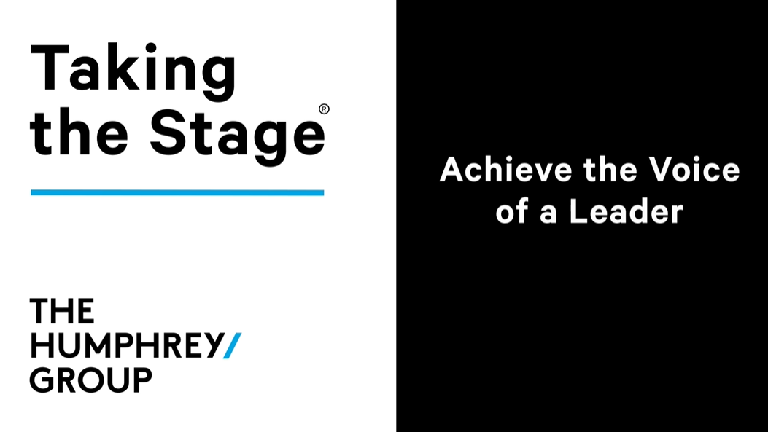
Notes:
Use the link provided to view the video.
https://vimeo.com/1089140808
Password to view videos: “THGTTS”

Slide 41

6 VOICE STRATEGIES
1
Expression
2
Pace
3
Volume
4
Clarity
5
Pauses
6
Pitch

Slide 42


BOX BREATHING EXERCISE
INSTRUCTIONS:
Close your mouth and breathe in slowly through your nose for 4 seconds.
Hold your breath for 4 seconds.
Open your mouth slightly and slowly exhale for 4 seconds.
Hold your breath again for 4 seconds.
Repeat this cycle four times to help relax and relieve tension.

Slide 43


USE ALL OF YOUR NOTES EXERCISE
INSTRUCTIONS:
Count from 1 to 5, using hand gestures to guide you through a range of tones from high to low. Try to reach as high and low as you comfortably can.
After the exercise, share how it felt to use your voice in this way and to hear such a range of tones.

Slide 44

ENUNCIATE TO INSPIRE EXERCISE
INSTRUCTIONS:
Get your Leader Script
Partner with someone and take turns reading your subject and message to each other with a pen in your mouth.
Share with the group how it felt to enunciate like that.

Slide 45
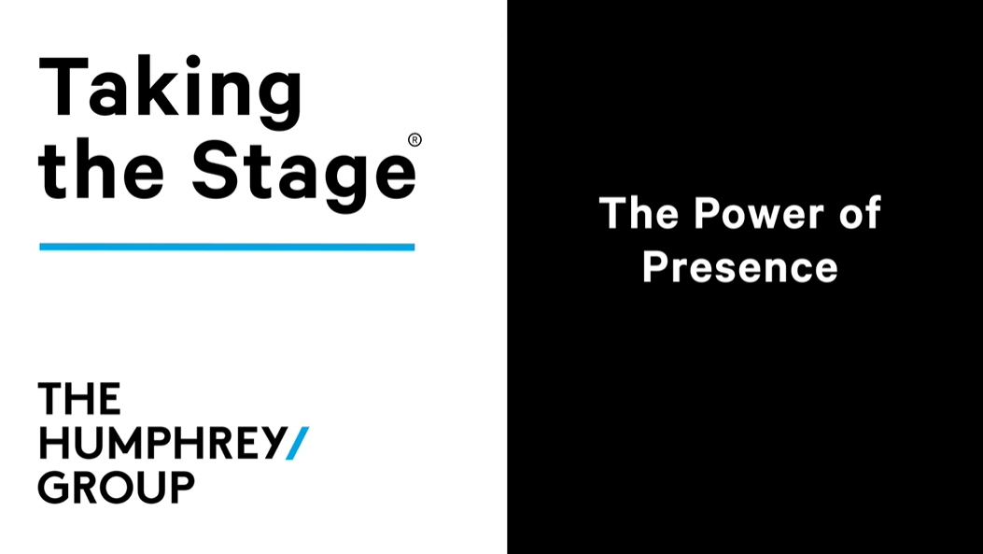
Notes:
Use the link provided to view the video.
https://vimeo.com/1089140160
Password to view videos: “THGTTS”

Slide 46





Body Language
Eye Contact
Pace
Expression

Slide 47
BREAK
- 15 minutes -

Slide 48

INDIVIDUAL PRESENTATIONS

Slide 49
INSPIRING CONVERSATIONS
EMBRACE YOUR LEADERSHIP IDENTITY
THE LEADER’S SCRIPT & THE LANGUAGE OF LEADERSHIP
POWER OF VOICE AND PRESENCE

Slide 50

Notes:
Use the link provided to view the video.
https://vimeo.com/1089139197
Password to view videos: “THGTTS”

Slide 51


ACTIVE LISTENING EXERCISE
INSTRUCTIONS:
Take on the role of the “speaker” or the “active listener.”
Speaker: Talk for 3 minutes about something that interests you.
Active Listener: Exhibit active listening behaviors for those 3 minutes.
Switch roles and repeat.
After each round, discuss what active listening strategies you used.

Slide 52
DISENGAGED LISTENING EXERCISE
INSTRUCTIONS:
Take on the role of the “speaker” or the “disengaged listener.”
Speaker: Talk for 3 minutes about a memorable professional experience.
Disengaged Listener: Show disengaged or distracted listening during the speaker’s talk.
Switch roles and repeat.
After each round, discuss how disengaged listening was demonstrated.

Slide 53




DEMONSTRATE THE THREE LEVELS OF LISTENING
Physical
Mental
Emotional

Slide 54





COMMUNICATING THROUGH CONFLICT
PROBE
Ask “what” and “how” questions
DISARM
Find common ground
EMPATHIZE
Acknowledge feelings
SUPPORT
Provide help, thanks, or praise
PERSUADE
Back to message

Slide 55

ACTIVE LISTENING TECHNIQUE
DISARM
Find common ground
E.g.
“It’s true that…”
“I agree that…”
“You’re right…”

Slide 56

ACTIVE LISTENING TECHNIQUE
EMPATHIZE
Acknowledge feelings
E.g.
“I can see that this is a difficult situation…”
“How are you feeling about this?”

Slide 57

ACTIVE LISTENING TECHNIQUE
SUPPORT
Provide help or praise
E.g.
“We’ve always been able to work through problems together…”
“You’re always honest in situations like these…”

Slide 58

ACTIVE LISTENING TECHNIQUE
PROBE
Ask “what” and “how” questions
E.g.
“What else are you feeling?”
“How can we move forward?”

Slide 59

ACTIVE LISTENING TECHNIQUE
PERSUADE
Back to message
E.g.
“And that’s why I believe…”
“I’m confident that we can…”

Slide 60
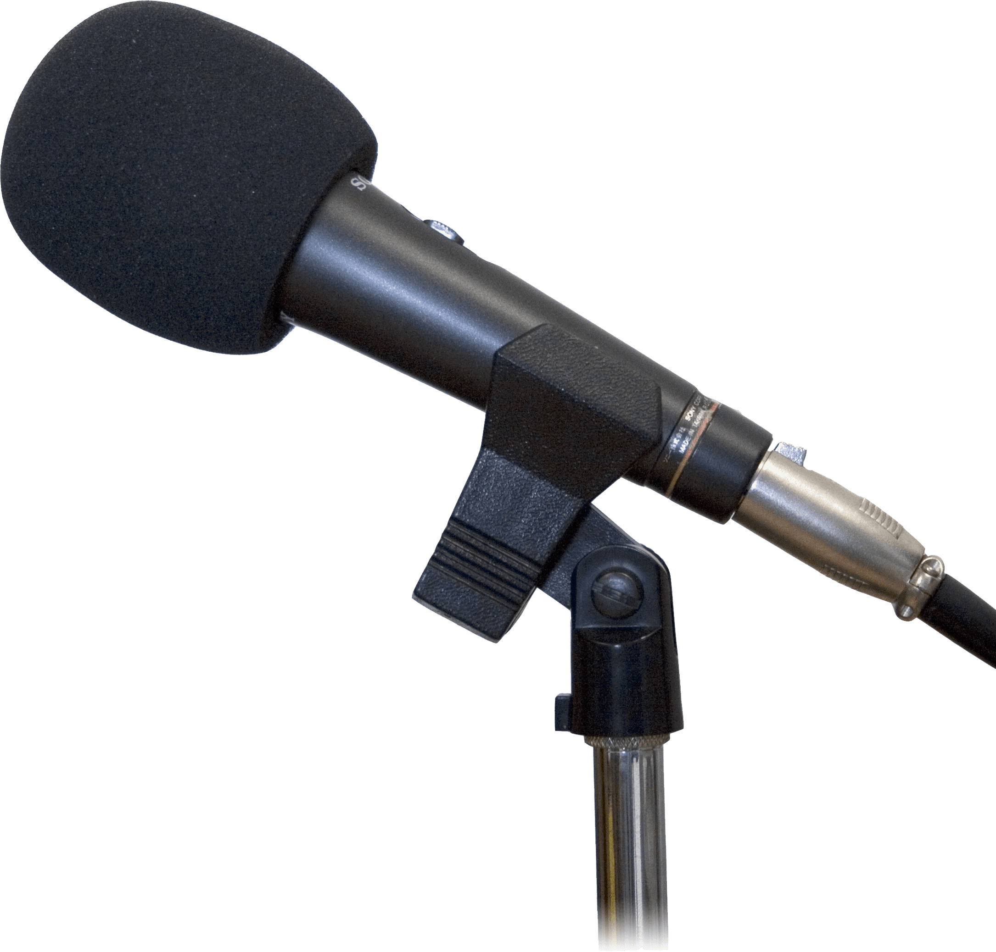
PRACTICE DESP
SPEAKER’S MESSAGE
“I firmly believe that by focusing on our communication we will improve our relationship.”
HOSTILE REPLY
“You have been here for 6 months and you haven’t prioritized communication in the past and it feels like nothing is going to change. I guess I will believe it when I see it.”

Slide 61
PRACTICE DESP
SPEAKER’S MESSAGE
“I believe that by increasing our marketing budget by 20% this quarter we will see massive returns.”
HOSTILE REPLY
“Well, where do you think we are going to get that budget from? We haven’t allocated for that. Where do you think you see that budget coming from?”

Slide 62
PRACTICE DESP
SPEAKER’S MESSAGE
“I can’t work with Jane.”

Slide 63

PRACTICING DESP ACTIVITY
INSTRUCTIONS:
Groups of 3: Assign yourselves one of these roles: “Speaker,” “Responder,” or “Observer.” You will switch roles each round.
Speaker: Provide a brief context about a challenging conversation and then recite your message.
Responder: Respond to the message with an impromptu pushback question.
Speaker: Use the DESP technique to respond to the pushback.

Slide 64
By taking the stage, you will thrive as a leader.

Slide 65

Taking
the Stage®
CALL TO ACTION

